Slide 1
Weekly Discovery Report 6
CycleSIGHT
Aiyana, Gloria, Farruh
CycleSIGHT: Because pain isn’t one-size-fits-all.

Slide 2
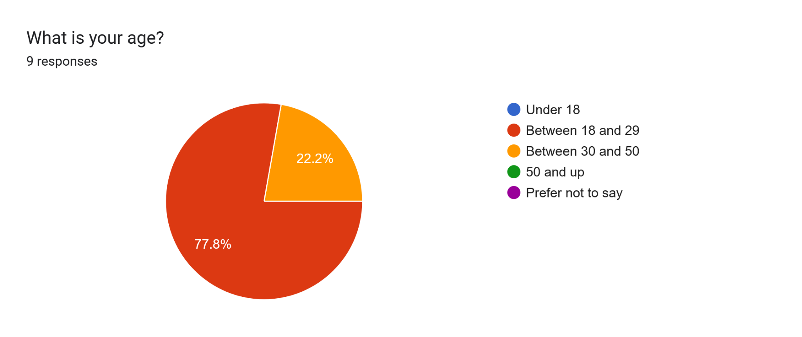
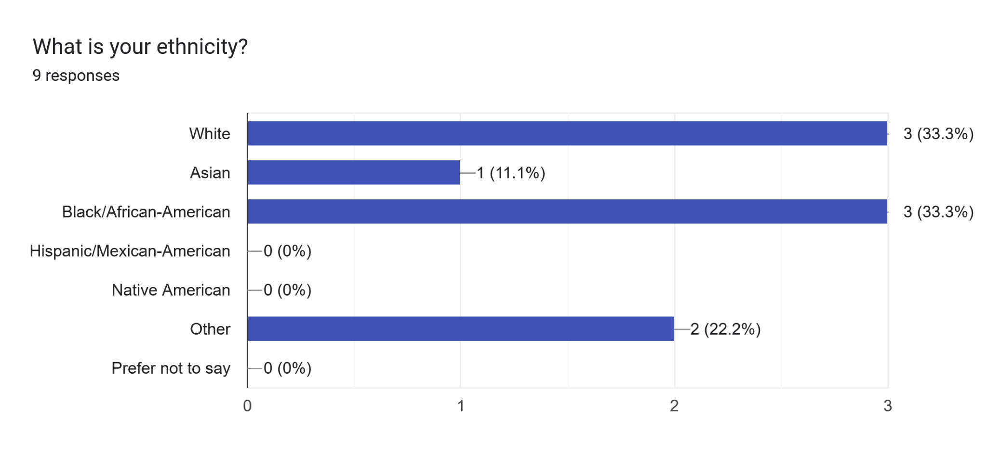
Q1.

Slide 3
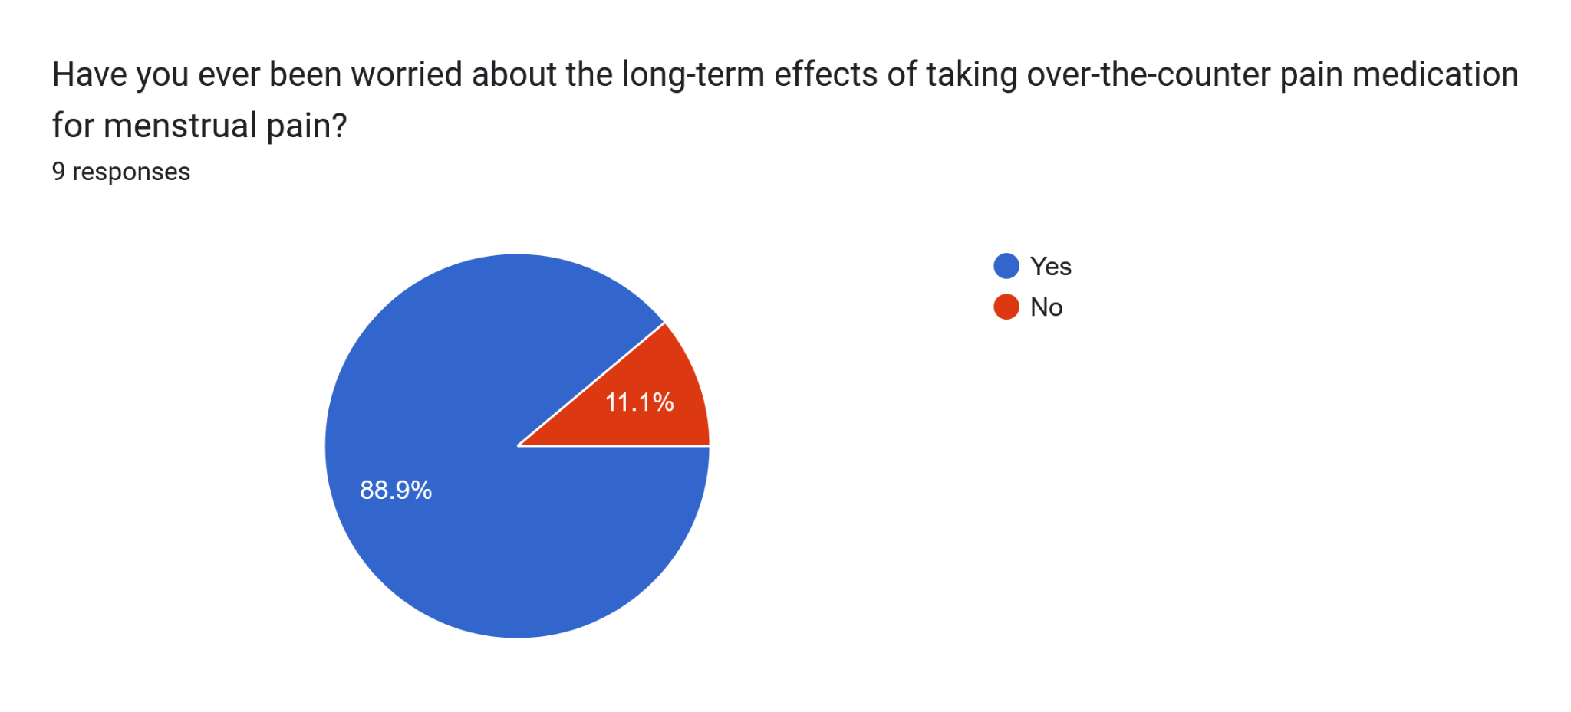
Q2.

Slide 4
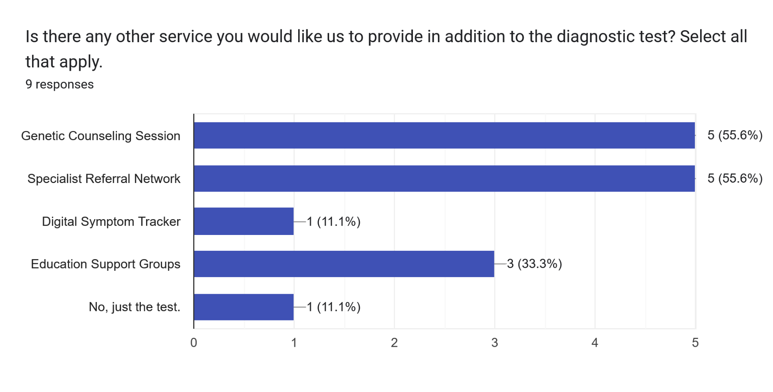
Q3.

Slide 5
Takeaways & Future Directions
Sufficiently sampled our direct target market
Dissatisfaction with current menstrual pain remedies
Interest in understanding the biological side of NSAID use
Concerns: Data Privacy & Cost
Shift focus to surveying clinicians
Gain insight into feasibility and implementation
How will it impact workflow?

Slide 6
Thank you.

